Slide 1


A Java Powered 2D Game

Slide 2



Project Introduction
A java application based on the java AWT & Swing package.
A 2D side-scrolling game
Notes:
http://www.hcxypz.com
https://today.mims.com

Slide 3

Idea:
Idea of the game ESCAPE is inspired by games like “Metal Slug” but with a gloomy and dark theme. The game is meant for entertainment purpose as the player will encounter different challenges and enemies. The character is lost in the mountains and he needs to find his way out but the path isn’t an easy one.

Slide 4

BASIC PROJECT REQUISITES
Java
Swing
EventListener
KeyListener
Jpanel
MouseListener
Runnable
Thread
KeyEvent
MouseEvent
Jframe
IO
BufferedReader
FileReader
File
Awt
Image
BufferedImage
Graphics

Slide 5









Basic Concepts Used
Inheritance
Overriding Paint() and Repaint() for Image Display
Implementing Runnable Interface
File Handling to Read Text File Levels
Running Threads
Exception Handling to ensure correct Image and File Loading
Overriding EventListener Methods
Creating and Running Game Loop

Slide 6

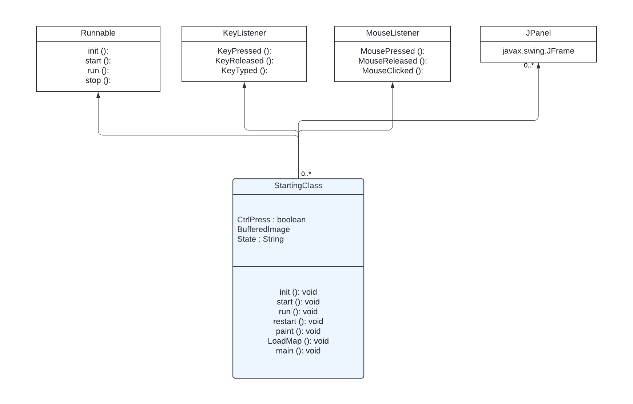
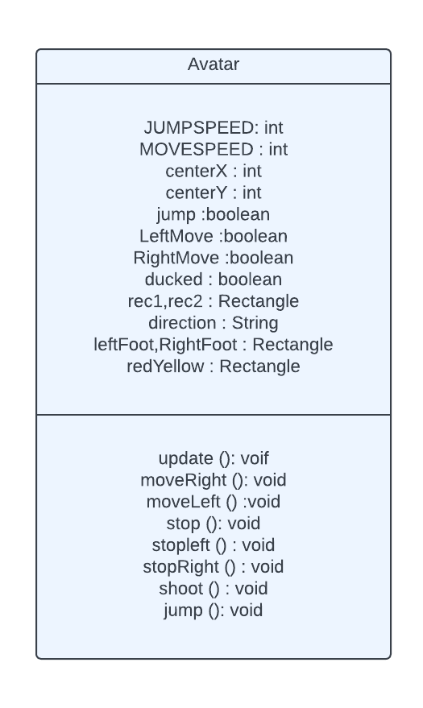
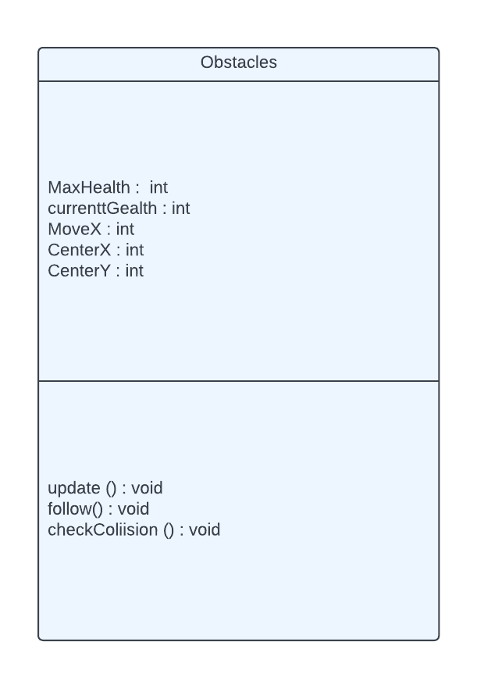
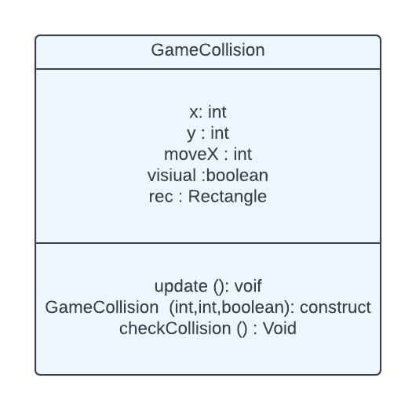
Final Code – Hierarchy

Slide 7
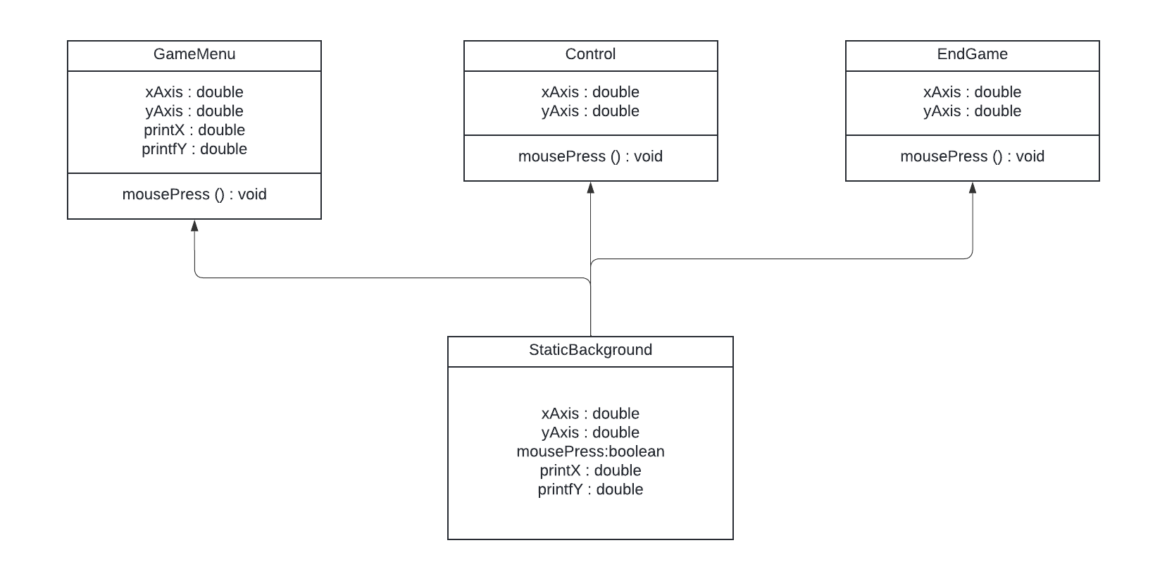
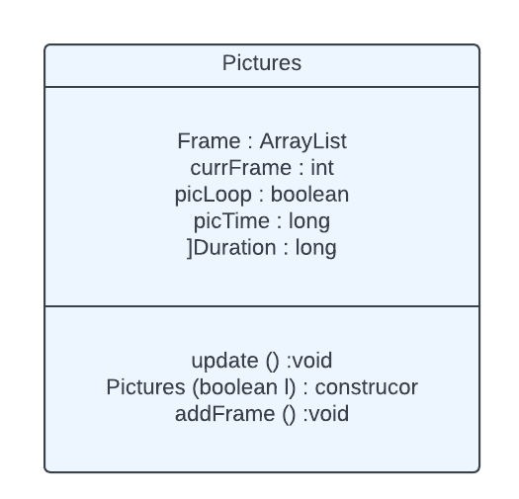
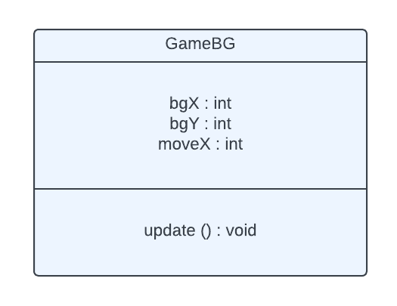
Final Code – Hierarchy

Slide 8


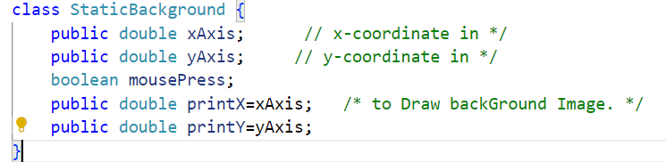
Background
We coded the logics so that the background contains three Buttons, we can invoke them using MouseClicked Event.

Slide 9
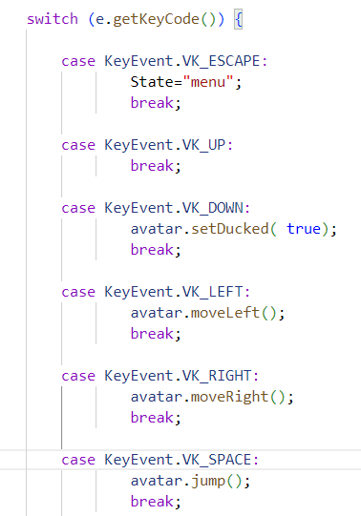
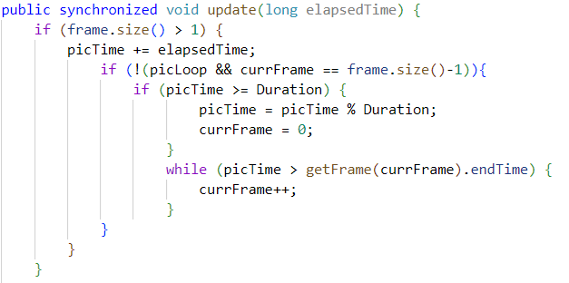
Event Handling
Animation Logic

Slide 10

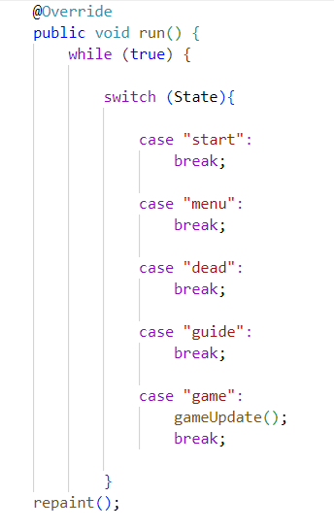
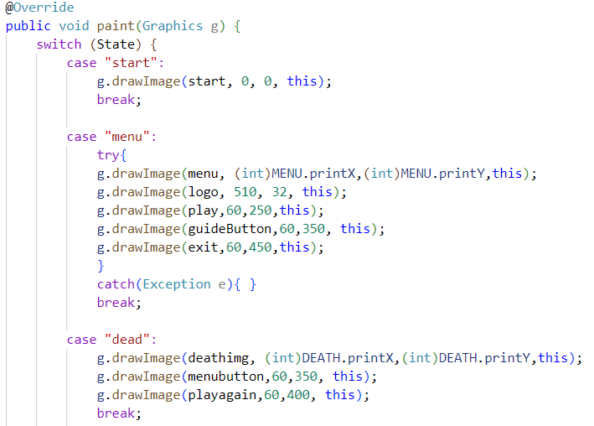
Game Loop
Overriden Paint() Method

Slide 11

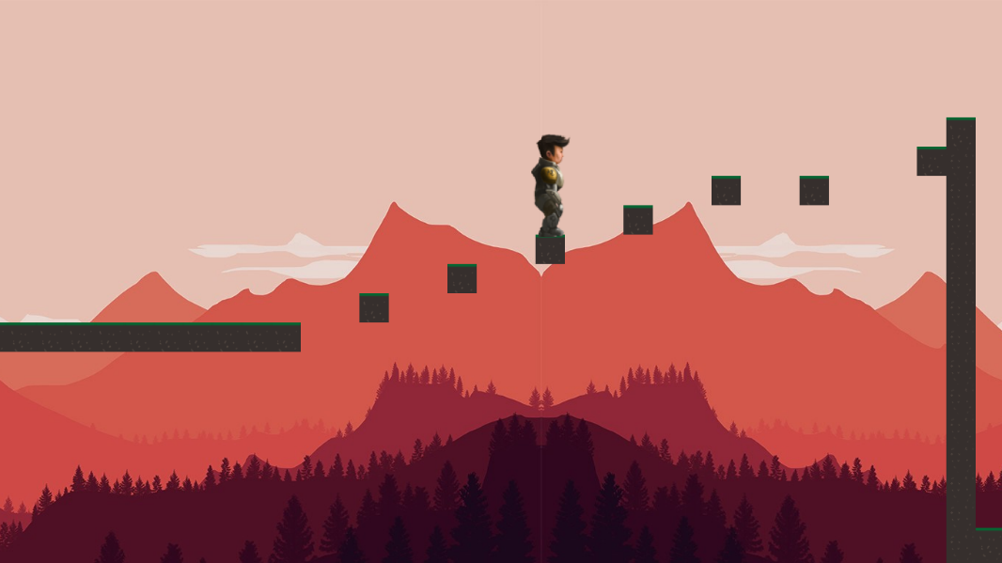
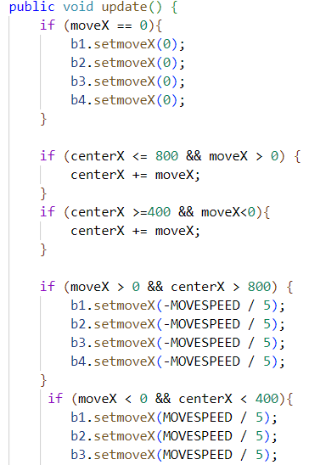

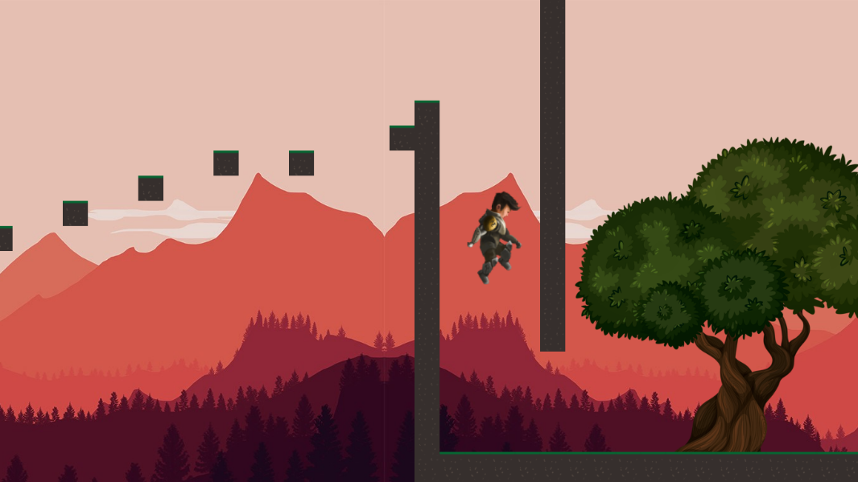
The Main Character

Slide 12


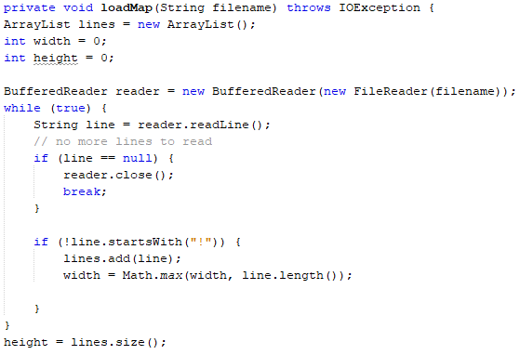
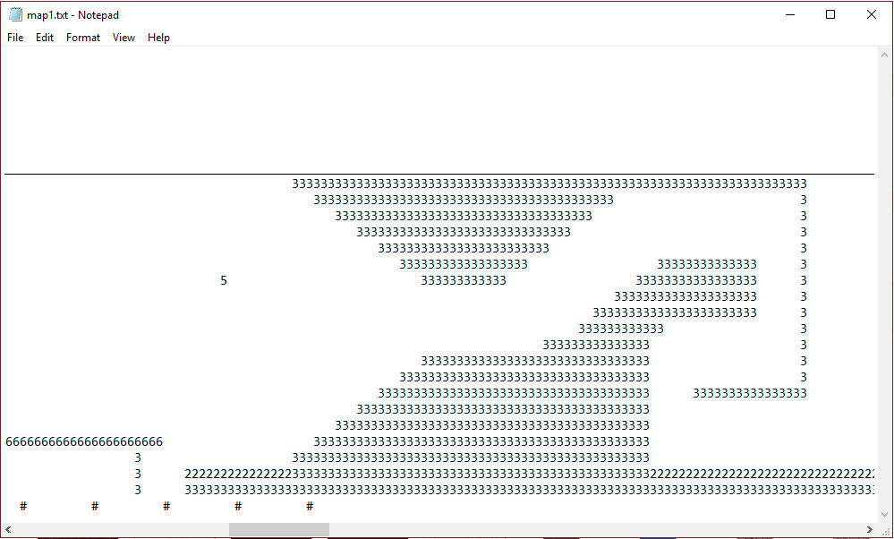
Loading Text File Maps
We created entire levels by mapping them out in a text file and then reading it into the Game. For every single digit, we associated an individual tile and all the tiles were different for different digits, giving us more flexibility to create more in-depth or simply put, more interesting levels.

Slide 13
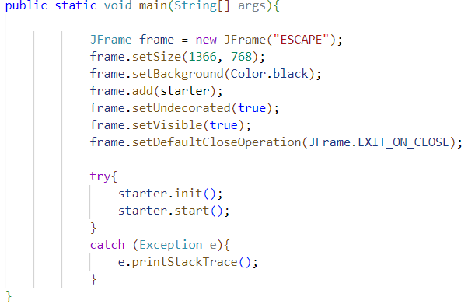
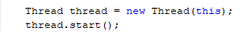
Starting Thread And Main() Method
We created a separate thread for the game by implementing the Runnable Interface. We started the thread in a separate start() method and called it within the main() method. Also, we did our best to keep the main function of the game as small as possible by putting everything like thread running and game loops and repaint processes in separate methods. This made it easy for us to debug or further upgrade the Game.

Slide 14
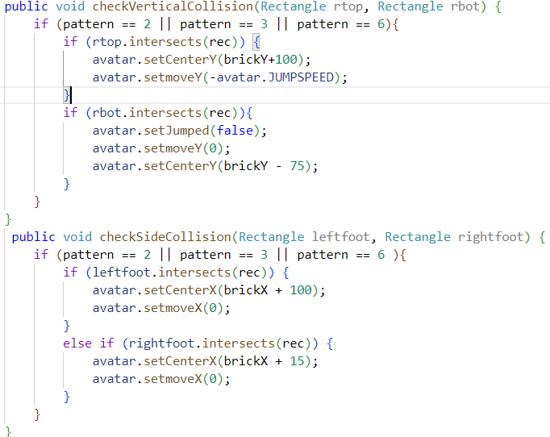
Collision and Physics Logic
We created separate logics for testing collisions of the characters with the level-tiles and other physical objects. Different algorithm had to be used for vertical and bottom collision with different resulting actions to deal with jumping and interaction with the ground.

Slide 15

End Semester Project Subject : Object Oriented Programming In Java
Semester : 2nd
Thank
You

